Slide 1
Building Resilience & Wellbeing One Wirral CIC Practice Managers Event - 28 June 2023
Dawn Scott
Director Healthskills Futures Ltd

Slide 2
Aims of the Session
Acknowledging the pressure that general practice is under right now
Pick up tips and techniques for building personal resilience for you and your team
Learn from each other through shared experiences
Exploring what you can do for yourself

Slide 3
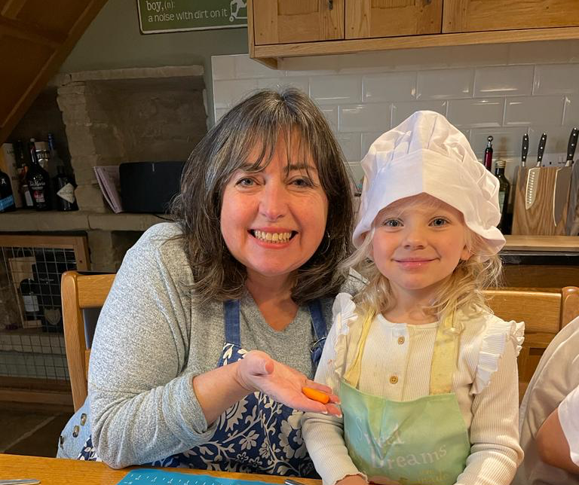

Slide 4
NHS Resilient Leadership
“Being a leader in the NHS — it’s bloody brilliant as a job. It really is. There’s nothing like it. But imagine if we got rid of all the sh*t around at the moment, with being treated poorly and being under constant pressure, how much more brilliant would it be?”
NHS Chief Executive
https://www.kingsfund.org.uk/publications/breaking-leadership-mould
22 August 2018

Slide 5
The current state of primary care…
“There is a real problem at the moment with chronic and destructive workload. What I mean by chronic is it is impossible to get on top of the workload, ever, anymore, which is a really hard thing to deal with. By destructive I mean that staff come in earlier and earlier, you go home later and later – and I mean, really late. “
Caroline Rollings NAPC Wellbeing Lead
Kings Fund 23 May 2023

Slide 6
So how do you deal with it…?

Slide 7
What is Resilience…?
“The capacity to remain flexible in our thoughts feelings and behaviours when faced by a life disruption or extended periods of pressure, so we emerge from difficulty, stronger, wiser and more able”
Carole Pemberton
Resilience A practical guide for coaches
Open University Press

Slide 8
What makes us resilient? (Pemberton 2015)
SELF BELIEF
The trust you have in your own actions and your capacity to deal with whatever comes your way
ELASTICITY
The ability to adapt to changing circumstances and not stay attached to what is familiar and comforting
MEANING
Having a sense of purpose; values or beliefs that inform your life
SOLUTION FINDING
Being able to work with what is there and being creative when resources are limited or options are narrow
SUPPORT
Able to access emotional support so that you know you are being listened to. Able to offer support to validate your worth
PROACTIVITY
Taking action to improve the situation rather than hoping things will get better or someone else will improve things for us
EMOTIONAL CONTROL
Being able to manage our emotions under pressure; to keep things in perspective rather than be overwhelmed by them
REALISTIC POSITIVITY
Facing the reality of the situation and assessing our strengths against that context.
“How can I make the best of what is happening right now?”

Slide 9
Resilience is not…
Working harder and harder and harder
Working faster and faster
Doing more and more and more… until you fall over

Slide 10
Examples of Resilience at Work
Emotional Insight
Balance
Positivity
Spirituality
Reflection

Slide 11
Exercise
Take 2-3 minutes to think about a challenging time/event in your life. Identify 1 or 2 actions that you took to cope with that challenge that made a positive difference to or helped with:
How you felt about issue
Your mental or physical health
How you moved forward
Share your thoughts with the person sitting next to you

Slide 12
5 Top Tips for: Building Personal Resilience
Know your purpose
Become comfortable with flexibility
Learn to face reality
Practice Self Care
Process failures and celebrate success
https://www.forbes.com/sites/forbesbusinesscouncil/2021/09/03/five-ways-to-building-resilience-as-a-leader/?sh=661d69ba12b5

Slide 13
4 Top Tips for: Building Team Resilience
TRAINING Knowledge Improvement & Team Bonds
DEBRIEFING Learning Lessons Mutual Support
SHARE RESOURCES guides, checklists SOPs
TEAM CULTURE
Care & Challenge Notice & Listen
Recognise & Reward

Slide 14
So what can I do to support my own wellbeing…?

Slide 15
WELLBEING

Slide 16
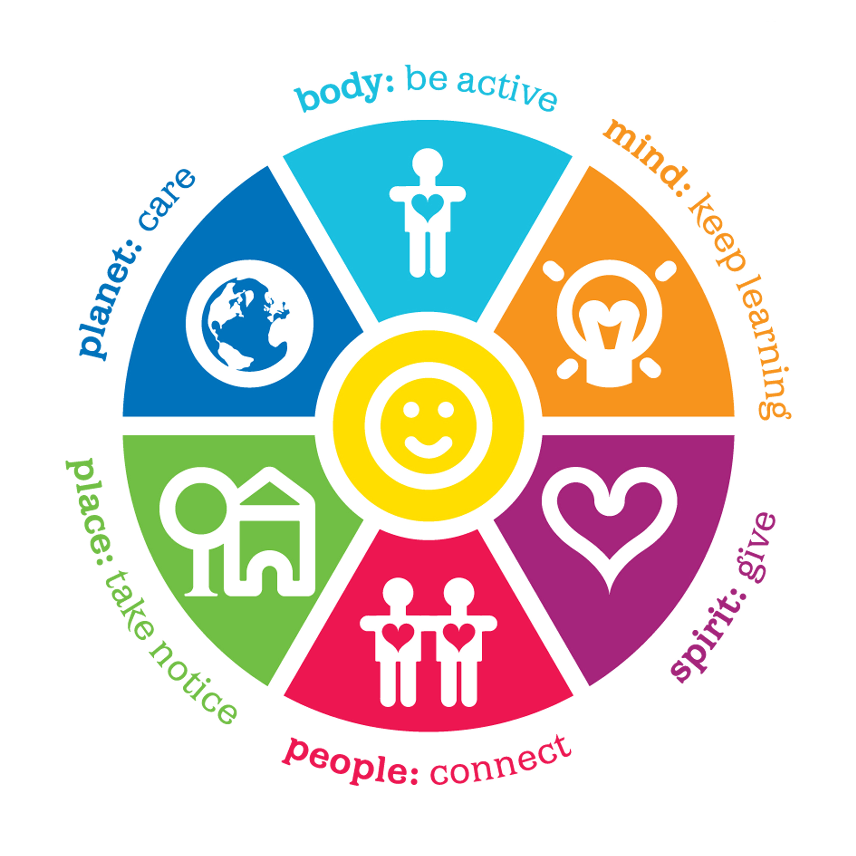
What can I do…?
Take a walk at lunchtime
Blogs Podcasts Audiobooks CPD
Recycle &
Grow
Volunteer – Give something back
Take notice of your surroundings
Take time to be with colleagues, friends & family

Slide 17
Practice Self Care

Slide 18
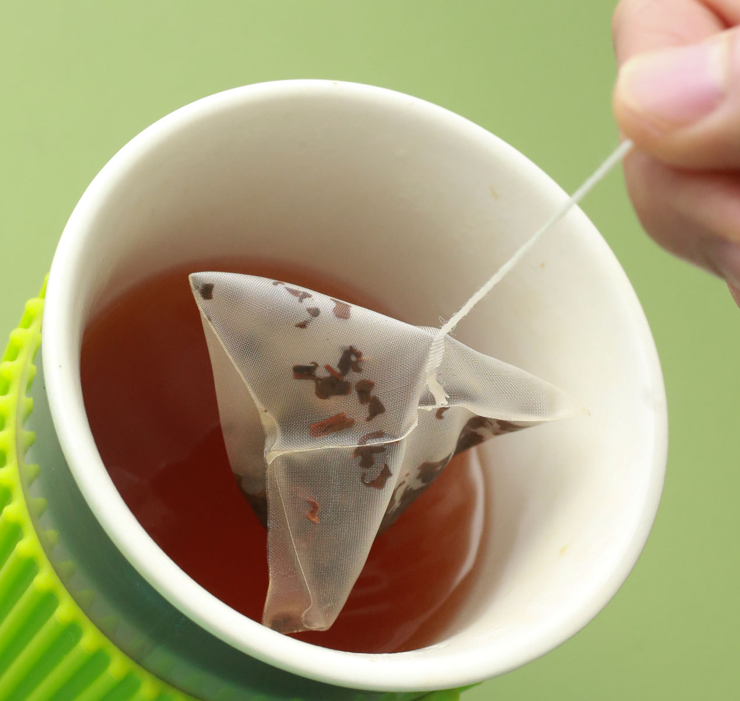
“People are like tea bags; they don’t know how strong they are until they are put in hot water…”
Eleanor Roosevelt

Slide 19
Take Away Team Exercise: Providing Positive Feedback
Aim of the exercise is to highlight people’s strengths and what you find positive about them
Each team member should provide some positive feedback for every other team member either spoken or written down in a template that everyone can see:
What am I good at?
What do you love about me?
What makes me a good colleague?
When you have concluded the exercise – discuss in a team meeting what impact that had on each of you. Repeat each year using new questions
Building Capacity

Slide 20
Useful References
https://www.kingsfund.org.uk/blog/2023/05/support-staff-wellbeing-primary-care-caroline-rollings
https://www.youtube.com/watch?v=zNra3ukROPU
https://networkofwellbeing.org/2015/07/29/sherry-clark-the-wheel-of-wellbeing/

Slide 21
Contact Details
If you are interested in discussing your Practice Development Needs, please feel free contact me as follows:
Dawn Scott, Director Healthskills Futures Ltd
Email: dawn.scott@healthskills.co.uk
Telephone: 07899994112
Our website is at www.healthskills.co.uk

